Slide 1
STRATEGIC THINKING AND BUSINESS QUALITY MANAGEMENT THROUGH BIOHACKING IN THE ERA OF DIGITAL TRANSFORMATION
PhD Student Vladimira Petkova, University of Library Studies and Information Technologies, Bulgaria
PhD Student Milena Petkova, University of Library Studies and Information Technologies, Bulgaria
PhD Student Bogomil Alexandrov, University of Library Studies and Information Technologies, Bulgaria

Slide 2
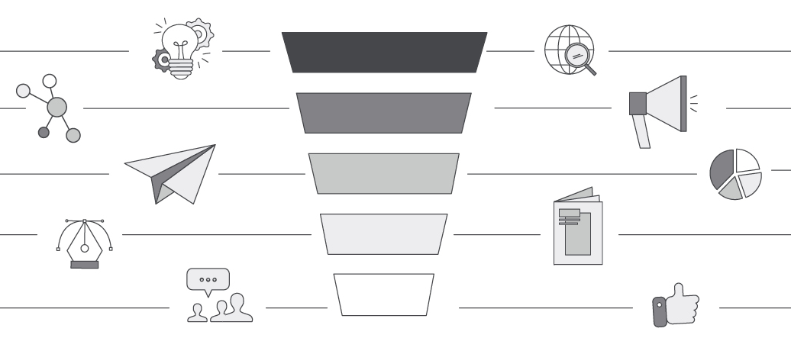
Content
Research Methods
Biohacking Specifics
Data Analytics
Use cases
Risk

Slide 3
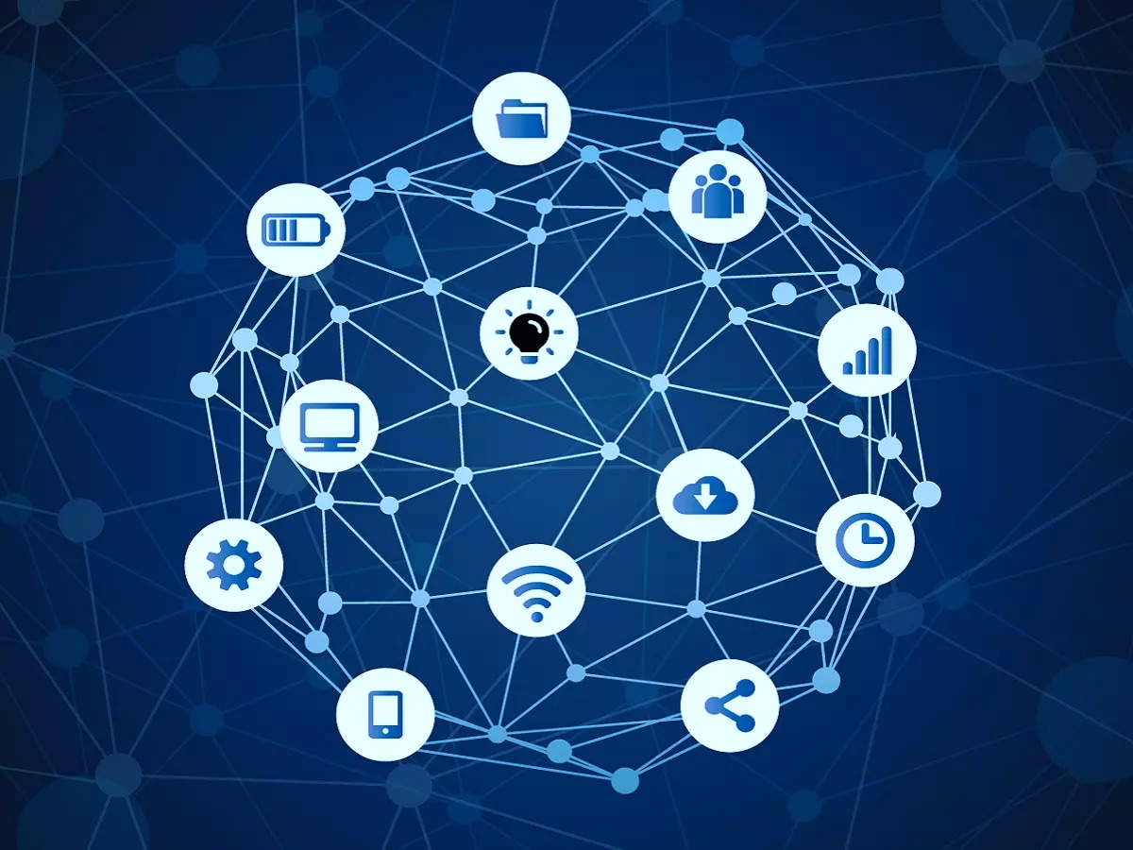
I. Key points
Digital Transformation - Challenges and Opportunities for Businesses
Importance of Information Technology in Quality Management
Automation and Digitalization for Market Competitiveness

Slide 4
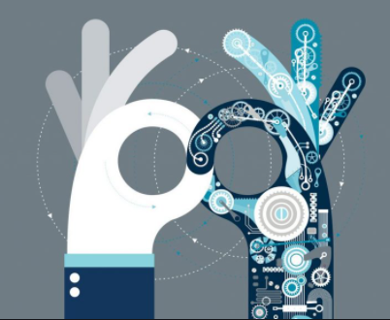
II. Research Methods
Literature review of scientific and business resources
Data and comparative analysis
Estimated pros and cons

Slide 5
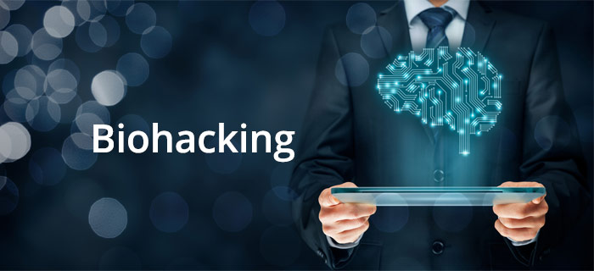
III. Research benefits
Biohacking as an alternative approach for corporate effectiveness and adaptability
Impact of Biotechnologies on Human Behavior and Business Process Management
Challenges and potential threats

Slide 6
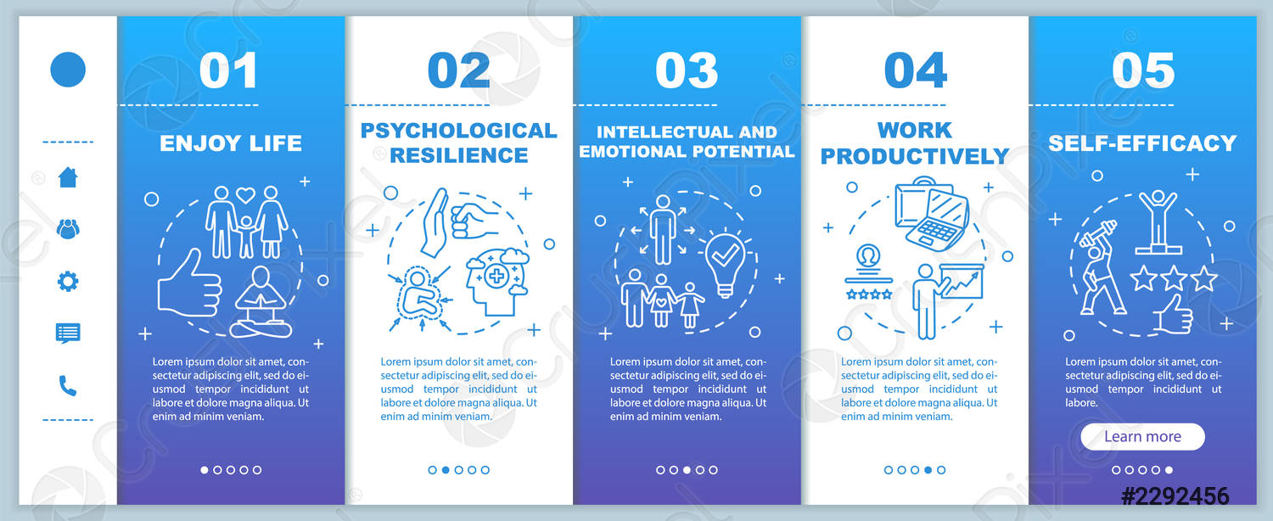
Practical Applications of Biohacking
Transforming Decision-Making Processes
Improving Workforce Well-Being
Enhancing Overall Organizational Procedures

Slide 7
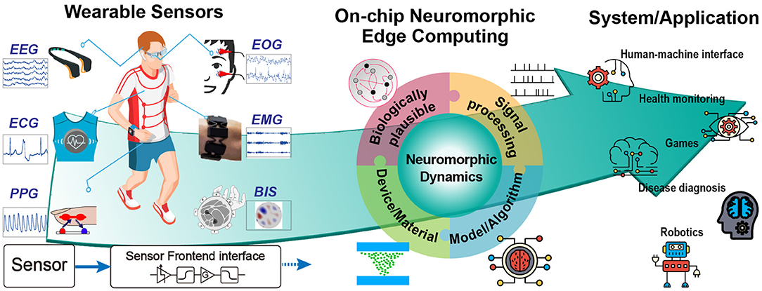
Integration Strategies
Wearable Technologies
Brain Stimulation
Health Monitoring
Genetic Modification

Slide 8
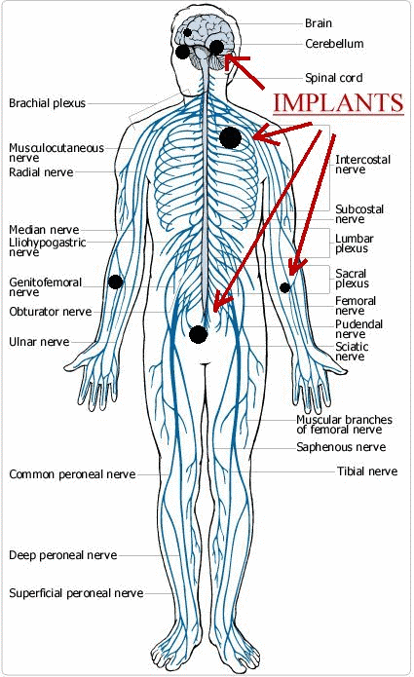
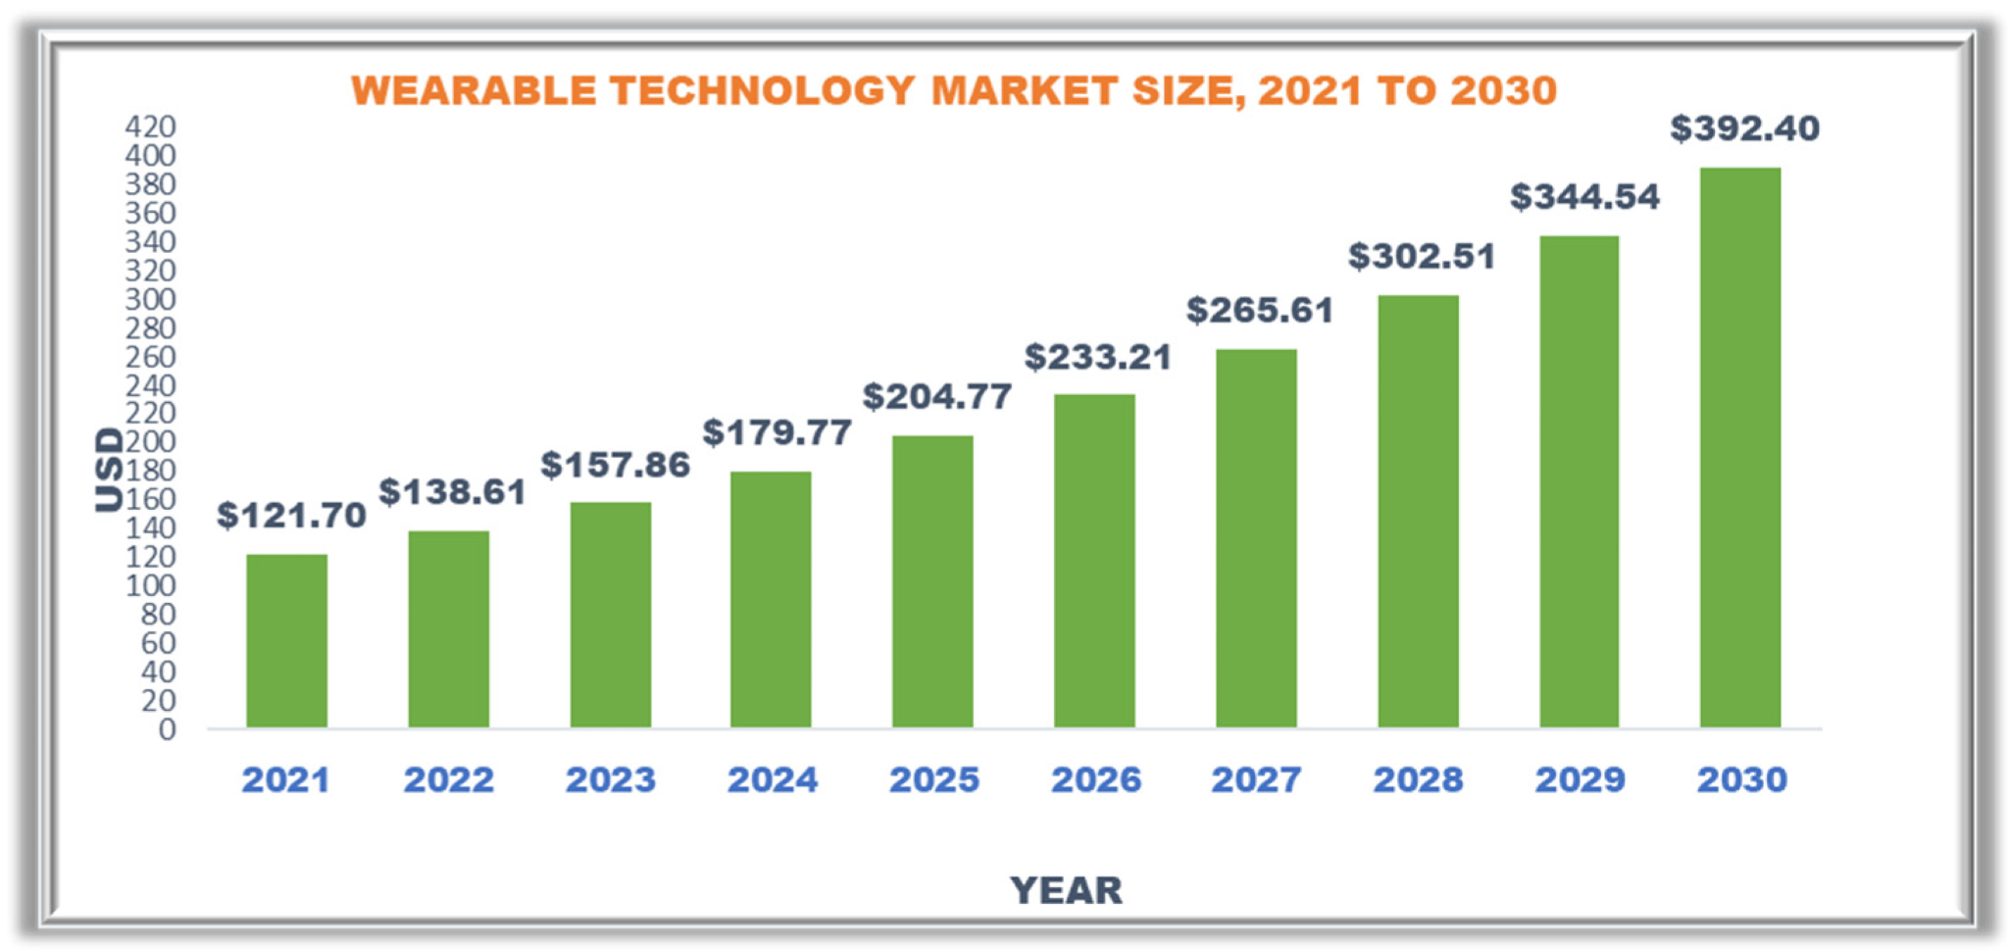
- Genetic modification
- Technological implants
- Implementation of wearable technologies and applications

Slide 9
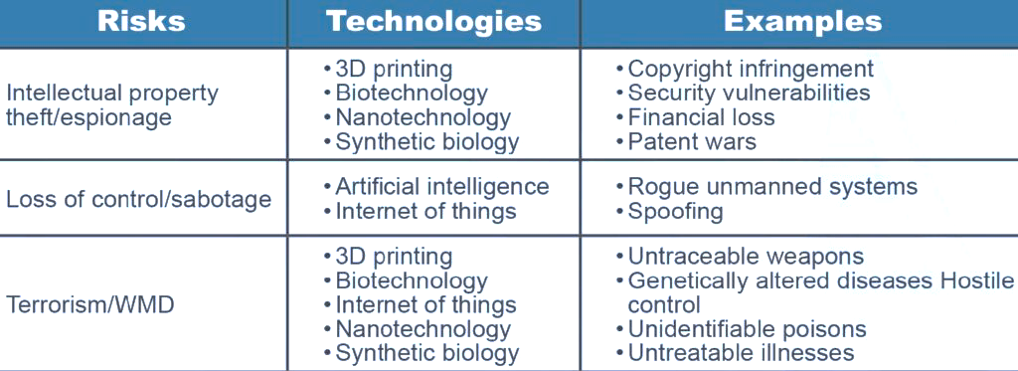
IV. Challenges and potential risks

Slide 10
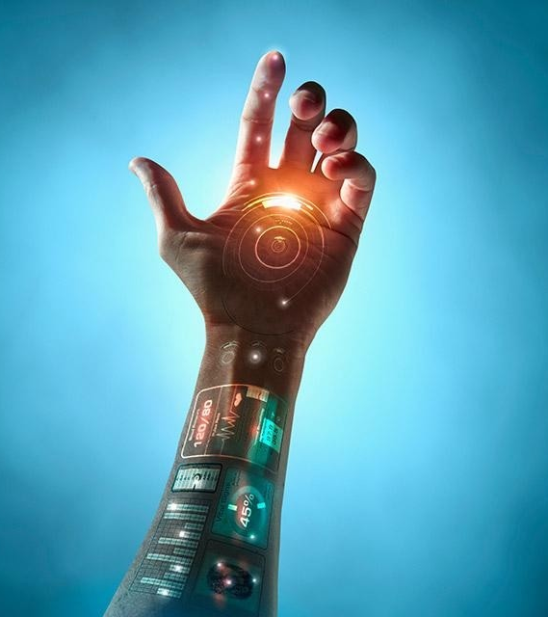
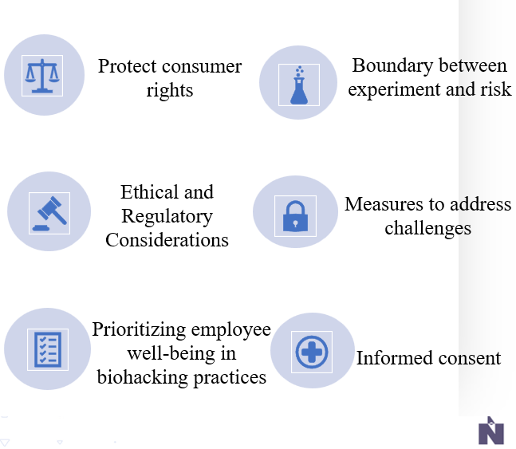
Discussion and Future Work

Slide 11
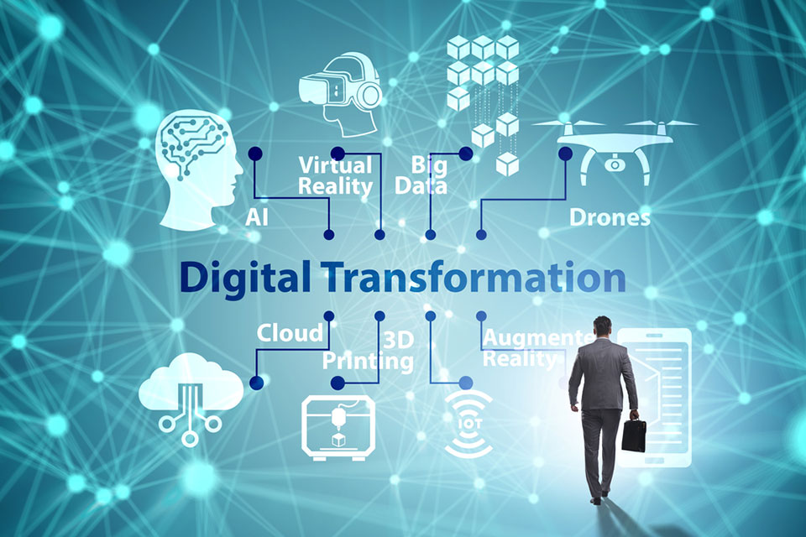
V. Conclusion
Digital transformation
Process optimization
Human performance improvement

