Slide 1
DECODING THE FOUNDATIONS FOR BULGARIA'S ECONOMIC FUTURE
Chief Assist. Dr. Sabrina Kalinkova
University of National and World Economy - Bulgaria

Slide 2
Problem?
ECONOMIC DEVELOPMENT
AND
PRIORITY INDUSTRIES

Slide 3
What?
PRIORITY INDUSTRIES IN BULGARIA
BEFORE AND AFTER THE
ACCESSION IN EUROPEAN UNION

Slide 4
How?
CHENERY-WATANABE METHOD
AND
RASMUSSEN METHOD

Slide 5
Using?
INPUT-OUTPUT METHOD
MATRIX OF DIRECT COSTS
MATRIX OF FULL COSTS

Slide 6

How?
$${wFL}_{i}^{ }= \frac{{FL}_{i}^{ }}{\left(\frac{1}{n}\right)\sum_{i=1}^{n}{{FL}_{i}^{ }}}.w$$
$${wBL}_{j}^{ }= \frac{{BL}_{j}^{ }}{\left(\frac{1}{n}\right)\sum_{j=1}^{n}{{BL}_{j}^{ }}}.w$$
PI = ${wFL}_{i}^{ }$ + ${wBL}_{j}^{ }$ > 1

Slide 7
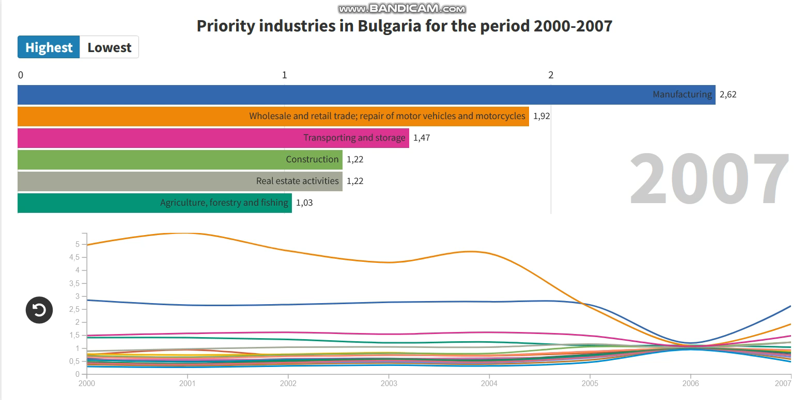

Slide 8
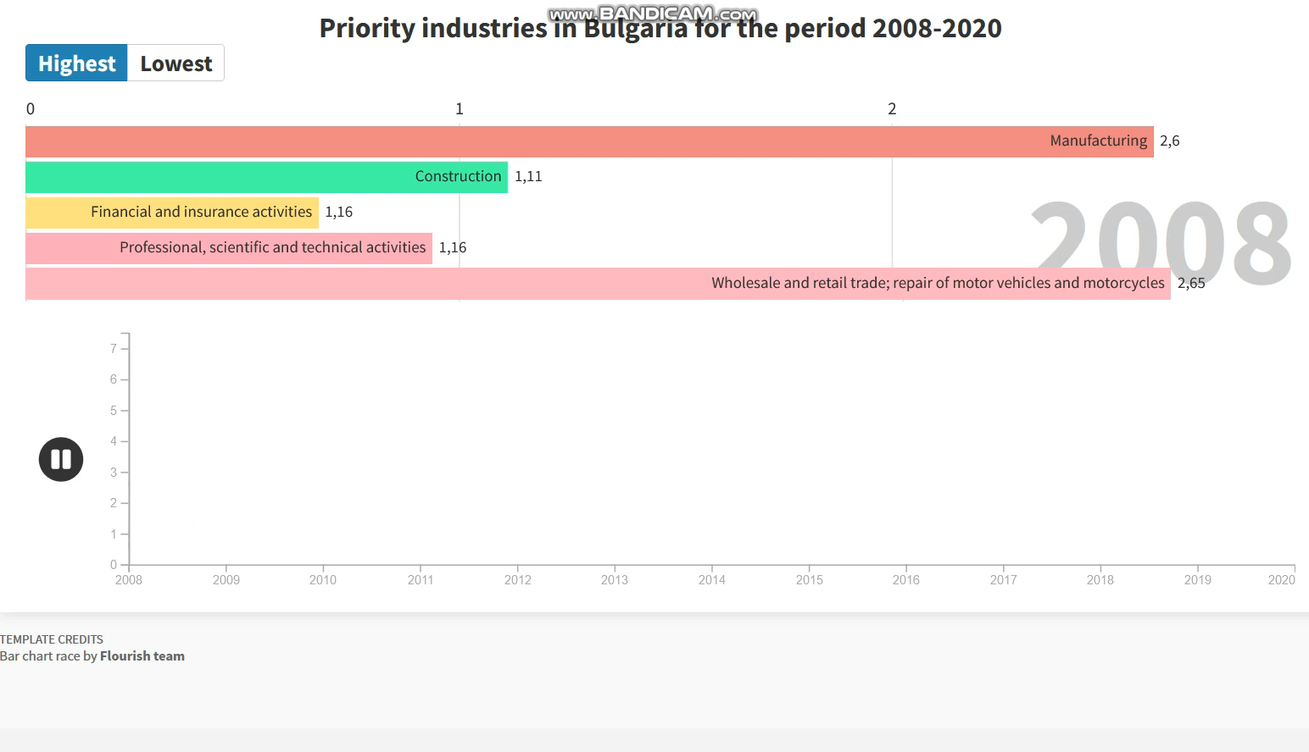

Slide 9
Conclusions:
Rasmussen method is better
Lower number of priority industries before the accession in EU
Almost no fluctuations

Slide 10
THANK YOU!

