Slide 1

STRATEGIES FOR DIGITAL TRANSFORMATION OF HUMAN RECOURCES IN TIMES OF COVID-19
Ph.D. student Viola Chakarova
University of National and World Economy (UNWE), Department of Management, Bulgaria

Slide 2
Topics of interest
Introduction
Digital transformation in the context of “Industry 4.0”
Digital transformation opportunities, challenges and technologies
Leadership and digital transformation
Digital transformation strategies within the framework of COVID-19
Digital transformation of human recourses in the Bulgarian industry
Conclusion and recommendations

Slide 3

Introduction
The onset of the Covid-19 pandemic further increases the need for digitization of processes, so that business activities can be carried out without the presence of the entire team, even remotely. To effectively optimize production through automation, leaders must seek to use technology in new ways.

Slide 4
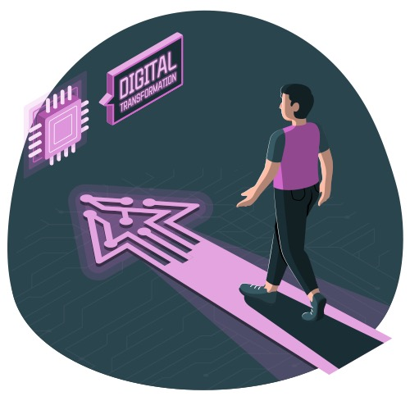
Digital transformation in the context of “Industry 4.0”
McKinsey describes the process as “an effort to enable existing business models by integrating advanced technologies”. “Industry 4.0” also aims to increase productivity and profits by using machines and intelligent components connected to the internet.
Source: Freepik

Slide 5
Opportunities
Increased efficiency and effectiveness of workflow;
Increased level of satisfaction in employees;
Introduction new business models;
Lower HR costs;
Automation of manual processes.
Source: Freepik

Slide 6
Challenges
Capital investment;
Resistance to change;
Data security and management;
Reorganization of work processes;
Lack of technological knowledge;
Poor management commitment for adoption of sustainability.
Source: Freepik

Slide 7

Digital transformation technologies
Cloud computing;
Internet of Things (IoT) ;
Augmented reality;
Artificial Intelligence (AI);
Data-Driven Decision or Big Data;
Robotic Process Automation (RPA);
Cyber security;
Machine learning;
Simulation.
Source: Freepik

Slide 8
Leadership and digital transformation
Based on 60 literature sources, researchers point out that the most important characteristic in leadership focused on digital transformation (digital leadership), are innovative visionary, networking intelligence, adaptivity to change, motivational coaching, digital and social intelligence, agility, and ability to learn from errors.
Source: Freepik

Slide 9

Digital transformation strategies within the framework of COVID-19
Disruptive digital transformation
Business model led digital transformation
Technology led digital transformation
Proud to be analog
Source: Freepik

Slide 10
Digital transformation of human recourses in the Bulgarian industry
According to the Digital Economy and Society Index (DESI) for year 2021, Bulgaria is on 26th place in the ranking of all 27 EU countries, second to last place in the ranking. According to the same report, 29% of the total Bulgarian population aged 16-74 wield basic digital knowledge, as opposed to an average of 56% for all EU countries.
2017
26th place
2018
27th place
2019
26th place
2020
2021
28th place
28th place
Source: European Commission

Slide 11
Digital transformation in Bulgarian medical centers
All participants use dominant platforms for information exchange.
All surveyed centres collectively agreed on the statement that digital transformation creates favourable work conditions for both staff and administrations.
There is a very positive outlook on the idea of comprehensive digital change and a great level of anticipation when it comes to digitalizing repetitive processes.
Just 15% of studied healthcare centres have set a digital transformation strategies in official business plan documentation

Slide 12
Research methodology
This study will present a multilateral research based on 42 respondents operating in 8 industries and multiple different levels of the organizational hierarchy. The survey is questionnaire, consisting of sixteen questions on the topic of digital transformation of human recourses in Bulgarian industries.

Slide 13
Research results
Q: Have you noticed a digital shift of your workplace in the past 3 years?
61,9% of respondents have been introduced to new software for automatization of repetitive work processes.
The majority of respondents (92,9%) have experienced digital transformation of their workplaces in the past three years.
Q: Have you been introduced to new software for automatization of repetitive work processes?

Slide 14
Communication tools are the most used tools amidst responders.
Q: What is your level of digital literacy skills?
Level of digital literacy skills could determine digital transformation knowledge.

Slide 15
Resistance to change and lack of digital education on manager’s side are most stated challenges workers have faced while working with new software and technological devices.
Q: Have you experienced any positive changes of management styles during the digital transformation process?
Respondents point out the positive change towards productivity, time efficiency and facilitation of work processes.
Q: Have you faced any of these challenges while working with new software and technological devices?

Slide 16

Conclusion
Based on the extensive literature review presented, it can be stated that effectiveness of management of human resources, financial resources, production, customer service and external factors is a subject to digitization and digital transformation for the purpose of increasing their productivity and its positive impact on the overall activity of organizations.

Slide 17
Recommendations
Digital transformation strategy should be completed by adequate training for usage of each new software and digital tool.
Managers should be well digitally educated.
Quality control should be digitized so that information is constantly collected on all stages of production processes.
Replacement of manual inspection business models with digital solutions powered by artificial intelligence.
Improvement of digital literacy skills.

Slide 18
References
[1] Bughin, J., Deakin, J, O'Beirne, B., “Digital transformation: Improving the odds of success”, McKinsey quarterly, 2019
[2] Schroek, M., Kawamura, J., Kwan, A., “Digital industrial transformation: Reinventing to win in Industry 4.0”, 2019
[3] Tosheva, E., “Economic and Social Benefits of Digital Economy and Digital Transformation in The Republic of North Macedonia”, Cilt/Volume 2, Sayı/Number 2, Aralık/December 2020 Sayfa/Pages 42-51
[4] Gadre, M., Deoskar, A., “Industry 4.0 -Digital Transformation, Challenges and Benefits”, International Journal of Future Generation Communication and Networking Vol. 13, No. 2, (2020), pp. 139 - 149
[5] Mohamed, M., “Challenges and Benefits of Industry 4.0: An overview”, International Journal of Supply and Operations Management, August 2018, Volume 5, Issue 3, pp. 256-265
[6] Schröder, C., “The Challenges of Industry 4.0 for Small and Medium-sized Enterprises”, 2017
[7] KPMG – India, “Convergence towards inclusive digital growth”, October 2018
[8] Antonopoulou, H., Halkiopoulos, C., Barlou, O., Beligiannis, G., “Transformational Leadership and Digital Skills in Higher Education Institutes: During the COVID-19 Pandemic.” Emerging Science Journal 5, no. 1, February 1, 2021
[9] Klein,M. (2020), “Leadership Characteristics In The Era Of Digital Transformation”, Business & Management Studies: An International Journal Vol.:8 Issue:1 Year:2020, pp. 883-902
[10] Afandi, W., “THE ROLE OF STRATEGIC LEADERSHIP IN DIGITAL TRANSFORMATION PROCESS”, IJRRAS 33, pp 19-22, November 2017
[11] Tekic, Z., Koroteev, D., “From disruptively digital to proudly analog: A holistic typology of digital transformation strategies”, Business Horizons, Volume 62, Issue 6, 2019, pp: 683-693,
[12] European Commission, “Digital Economy and Society Index 2021Bulgaria”, 2021
[13] Dragomirov, N., Boyanov, L., “Digital transformation challenges of logistics in Bulgaria”, 2021, IOP Conference Series: Materials Science and Engineering
[14] Mihaylova, L., Papazov, E, Andreev, L.,, “Digital Transformation of Health Services Provided by Medical Centers in Bulgaria”, International Conference at the Brno University of Technology, 2021, pp 75-81

