Slide 1
VOICE TRAINING AS A KEY COMPETENCE FOR STUDENTS IN TEACHER TRAINING
BENEFITTING FROM A VIRTUAL REALITY CLASSROOM IN HIGHER EDUCATION
Dr. Ulrike Nespital, researcher and lecturer, project management
Gerald Czerney, software engineer, technical lead

Slide 2
AGENDA
VOICE TRAINING FOR STUDENT TEACHERS—UTILIZING Virtual Reality (VR) HEADSETS
SOFTWARE SPECIFICATIONS
PILOT STUDY
CONCLUSION

Slide 3
1. VOICE TRAINING FOR STUDENT TEACHERS—UTILIZING VR HEADSETS
Initial situation and reason for the project:
Studies show that teachers have a high speaking load and often have major voice problems as a result [1] [2] [3] [4] [6]
Learning objectives:
Understanding the correlations of physiological phonetics
Distinguishing and identifying features of healthy and impaired vocalization
Differentiating and describing the functions and relationships between posture, breathing, voice and articulation
Identifying characteristics of their own voice and applying economical and prophylactic exercises
Transferring these exercises to classroom teaching situations using VR headsets
Using this training as preparation for real time classroom teaching situations

Slide 4
2. SOFTWARE SPECIFICATIONS
SIMPLE SOFTWARE DEVELOPMENT METHODS:
Incremental/agil software developement process
TOOLS:
Unity development environment [11]
Ready Player Me for creating avatars [10]
Mixamo for combining animations with avatars [8]
Picovoice tool set for implementing a voice recognizer [9]

Slide 5
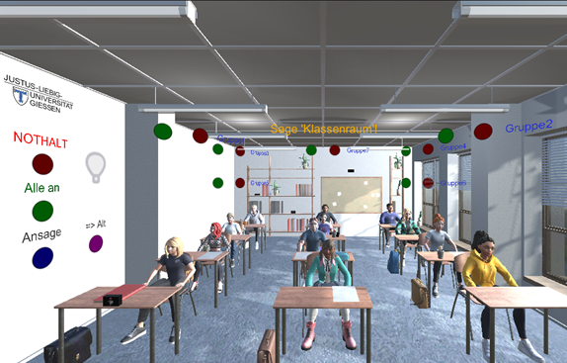
2. SOFTWARE SPECIFICATIONS

Slide 6
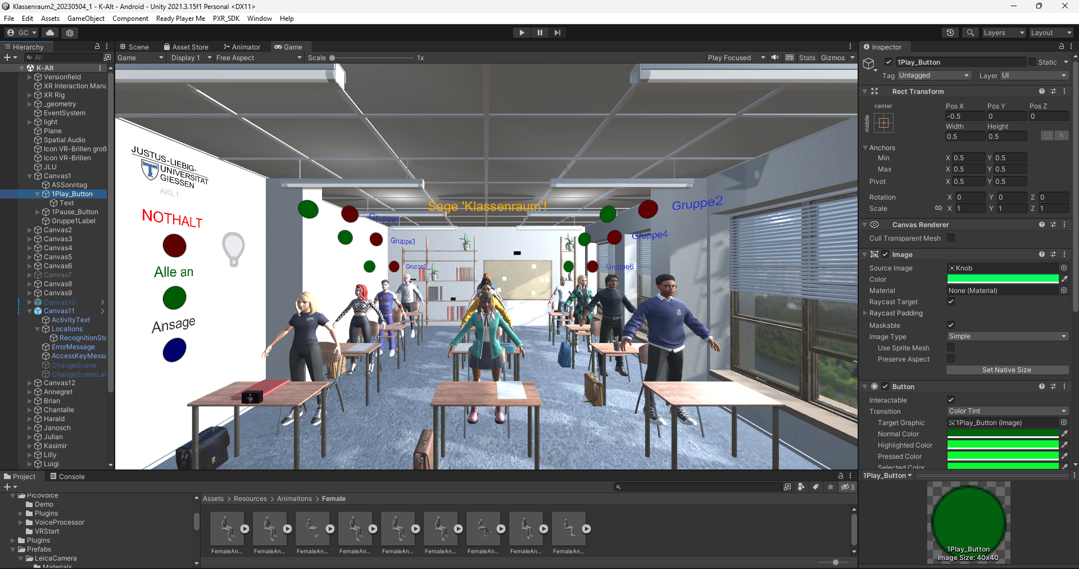
2. SOFTWARE SPECIFICATIONS

Slide 7
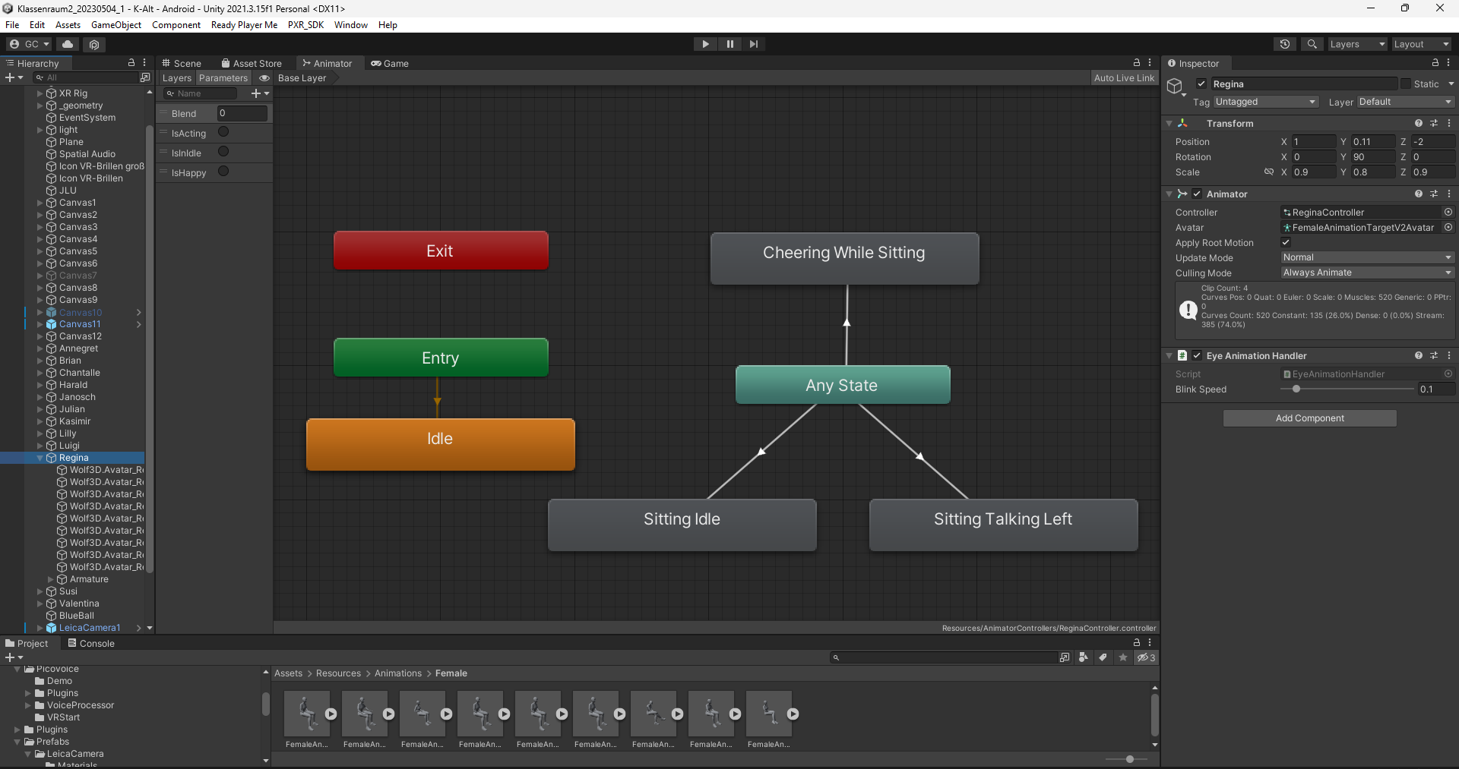
2. SOFTWARE SPECIFICATIONS

Slide 8
2. SOFTWARE SPECIFICATIONS
Virtual classroom featuring school children avatars
Activation buttons for avatars
Sound files and avatar movements triggered upon activation
Reusability of existing development environments and assets
Voice recognizer for deactivating the movements and stopping the sounds of the avatars
Spatial Audio
Quick VR headset update capabilities

Slide 9
3. PILOT STUDY - OVERVIEW
The pilot study belongs to the Scholarship of Teaching and Learning (SotL) research area [5].
The seminar was held for the first time in the summer semester of 2022 (three times since then).
Questionnaires were conducted on the participants' own voice perception and VR experience [6] .
The concept and the technology were continually adapted based on the experiences and feedback.
A research environment with consistent conditions could not be established in the pilot run.
All 19 student teachers predominantly rated the VR experience in the seminar as positive and associated little to no negative feelings with the VR experience.
First results indicate that the students improved their vocal quality and found the VR experience to be positive.

Slide 10
3.1 Positive statements about the VR experience

Slide 11
3.2 Negative/neutral statements about the VR experience

Slide 12
4. CONCLUSION
For a healthy voice in teachers, a teaching concept was developed.
A virtual classroom filled with noisy school children’s avatars.
The students learned vocal techniques to professional practice and to exercise it in a challenging classroom situation.
Using user-friendly tools simplified significantly the technical execution of the project.
The voice recognition system enabled student teachers to gain instant feedback by silencing noisy avatars.
First results indicate that the students improved their vocal quality and found the VR experience to be positive.
The project is ongoing and will be extended in the next years.

Slide 13
REFERENCES
[1] Angelillo M., .Di Maio G., Costa G., Angelillo N., Barillari U., Prevalence of occupational voice disorders in teachers, Germany, J PrevMedHyg, vol. 50/issue 1, pp 26-32, 2009;
[2] Van Houtte E., Claeys S., Wuyts F., Van Lierde K.., The Impact of Voice Disorders Among Teachers: Vocal Complaints, Treatment-Seeking Behavior, Knowledge of Vocal Care, and Voice-Related Absenteeism, Journal of Voice, USA, vol 25/issue 5, pp 570-575, 2010;
[3] Bermúdez de Alvear R. M., Martínez G. A., Barón, F. J., Hernández-Mendo A., An interdisciplinary approach to teachers' voice disorders and psychosocial working conditions. Folia Phoniatr Logop. Vol. 62/issue 1-2, pp 24-34, 2010;
[4] Gutenberg N., Pilotstudie zur Karriere von Lehrerstimmen mit stimmpathologischem Befund, bzw. Prognose eines stimmpathologischen Risikos unter Unterrichtsbelastung. Ein Forschungskonzept. Campus University of the Saarland, vol. 1, 2003;
[5] Huber L., Pilniok A., Sethe R., Szczyrba B., Vogel M Forschendes Lehren im eigenen Fach. Scholarship of Teaching and Learning in Beispielen, Germany, 2019; https://www.pedocs.de/volltexte/2015/10129/pdf/Huber_2014_Scholarship_of_Teaching_and_Learning.pdf
[6] Lemke S., Die Funktionskreise Respiration, Phonation, Artikulation –Auffälligkeiten bei Lehramtsstudierenden, Sprache -Stimme -Gehör, Germany, vol 30, pp 24-28, 2006;

Slide 14
REFERENCES
[7] I. Jsselsteijn, W. A., de Kort, Y. A. W., & Poels, K. (2013). The Game Experience Questionnaire. Technische Universiteit Eindhoven.
[8] https://www.mixamo.com/#/
[9] https://picovoice.ai/
[10] https://readyplayer.me/de/avatar
[11] https://unity.com

Slide 15
Thank you for your attention!

